Slide 1
KOWIN Eastern Region WASHINGTON D.C. CHAPTER
President: Myong Ho Nam, M.D.

Slide 2
[Reports on September – December, 2010 Activities]
Program Title: Next Generation Leadership Mentoring Seminar, “Raising the Bar”
Purpose: Identify and Nurture Creative and Competitive Young Korean-American Women Professionals to become next generation of global leaders
Duration: October 19, 2010 – December 5, 2010
Key Elements:
November 21, 2010: Seminar was held at the Korean Ambassador's Residence Banquet Hall
130 participants including young professionals, KOWIN members including NY and Chicago, and other organizational women leaders.
Key note speaker: Dr. Sue Terri - Former Deputy assistant secretary for National Security Council
8 additional mentors (KOWIN and non-KOWIN members) participated representing government, healthcare, media, education, business, international organization, etc., and provided guidelines for successful career development and personal and family life balance.

Slide 3
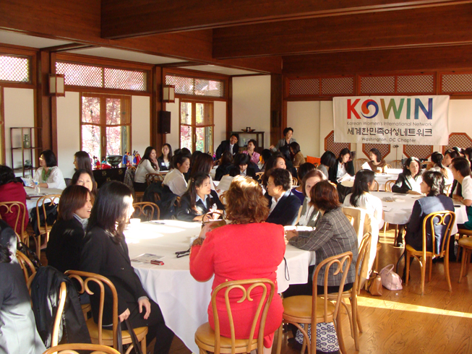
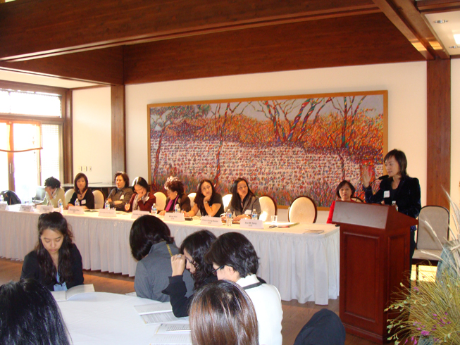

Slide 4
[Reports on September – December, 2010 Activities]
Program Title: Year-End Party, “Celebrating Women’s Physical, Mental, Social & Cultural Well-being"
Purpose:
Celebrating the achievement of 2010 and fundraising art show for 2011activities
Duration: December 28, 2010 – January 31, 2011
Brief Description of Main Program Contents:
Hongja Komelia O’Kim: Professor, Montgomery College – Topic: Collecting Art
Sue Vittas-Shin: IT Team Leader, IMF – Topic: International Protocols and Etiquette for Women, and their importance in soft skills for successful career.
Myong Ho Nam: Medical Director, Clinical Laboratory Services at Inova Fiarfax Hospital – Topic: Women’s Health issues: Importance of regular check up and 7 early signs of cancer and preventive measures as well as management of Women’s health problems.

Slide 5
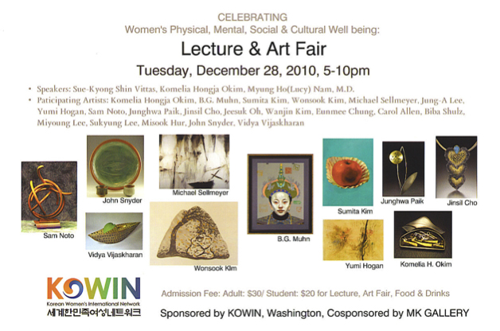
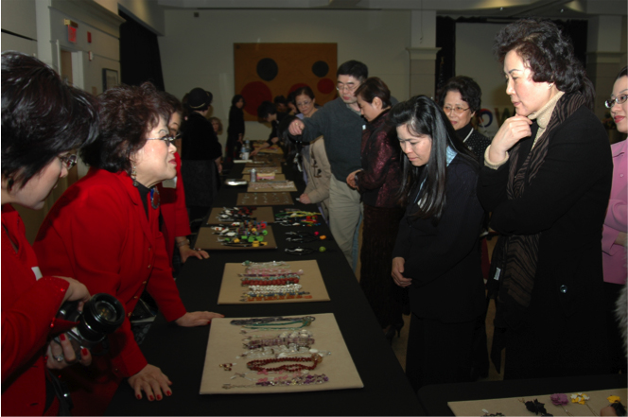

Slide 6
[Reports on January – August. 2011 Activities]
Program Title: Dinner Reception for the Washington-Metropolitan Area’s Korean-American Women Leaders with the Minister of Korean Ministry of Gender Equality and Family
Purpose: To promote the active interaction and collaboration between the Korean Ministry of Gender Equality and Family and the Washington DC area’s Korean-American Women.
Date: February 25, 2011

Slide 7
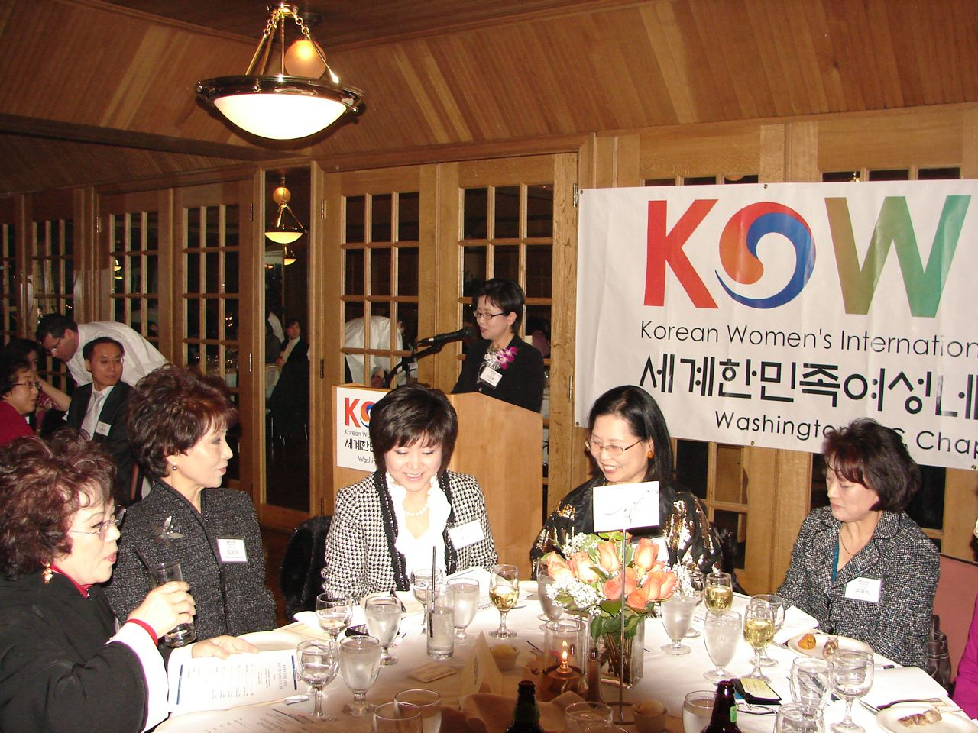
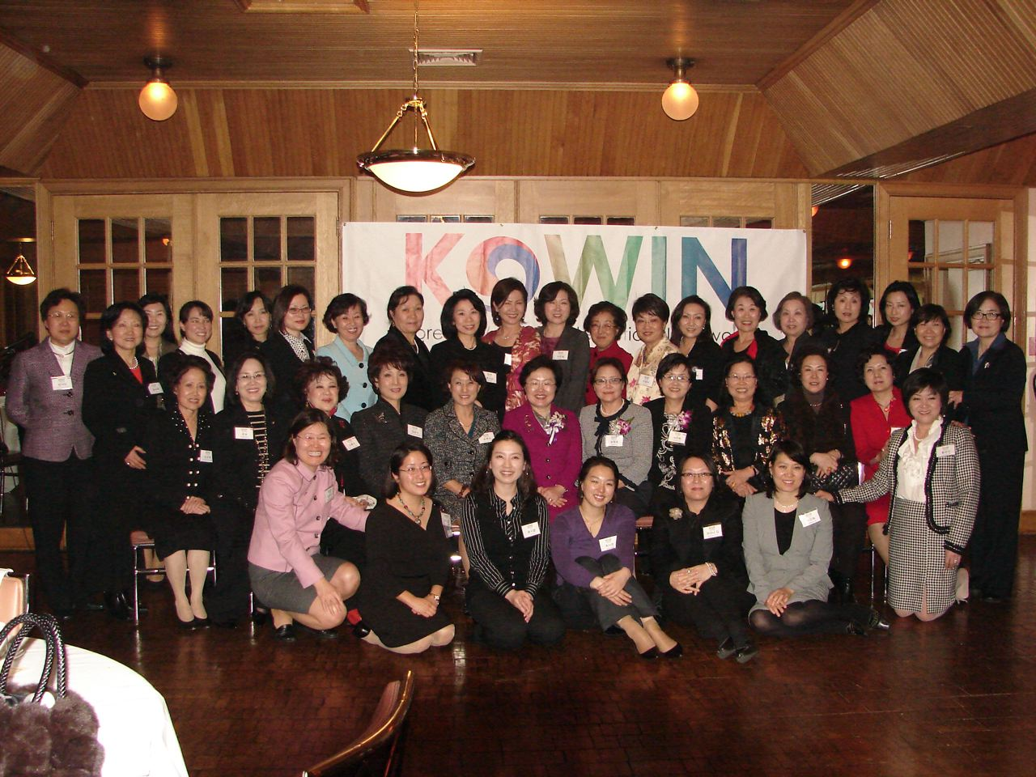

Slide 8
[Reports on September, 2010 – August, 2011Activities]
Meetings: Quarterly regular membership meetings, Annual Executive Committee meeting, Monthly/On-demand Committee meetings
Reporting on the previous quarter activities
Networking and Educational Seminar
Planning and delegating for the future activities
Held in September, 2010; March & July, 2011
Fundraising Art Show:
In collaboration with Washington Area’s Artists and MK Gallery, three Art Shows were held.
December, 2010; April-May, 2011; July, 2011
Profits will be used for the KOWIN DC Fellowship Program and the Next Generation Leadership Mentoring Seminar.
Publication of KOWIN DC Newsletter and Launching of Website

Slide 9
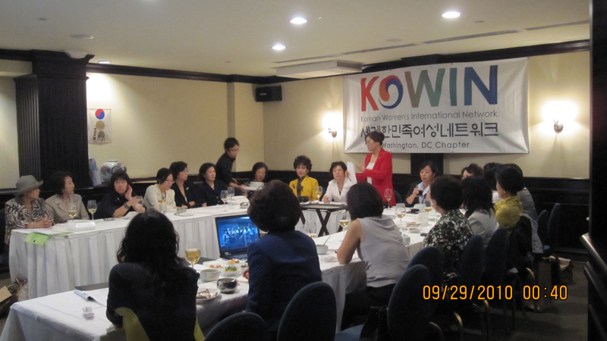
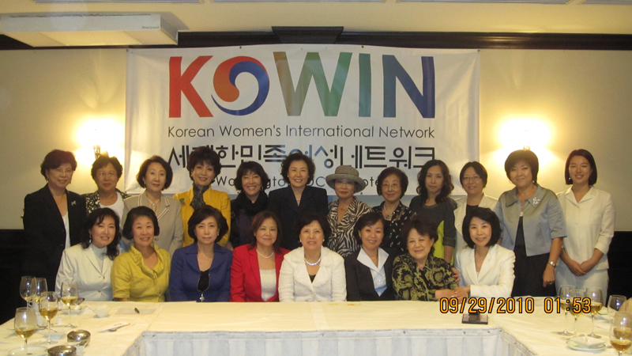

Slide 10
KOWIN DC e-Newsletter
Published 3 times a year
1st volume: October, 2010
2nd volume: February, 2011
3rd volume: October, 2011
Both English and Korean versions are distributed to the KOWIN DC members, Friends of KOWIN DC, local organizations and other supporters.

Slide 11
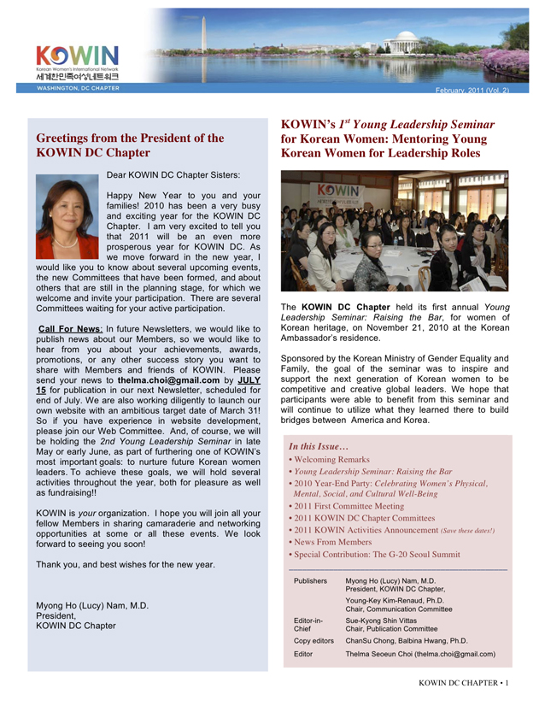
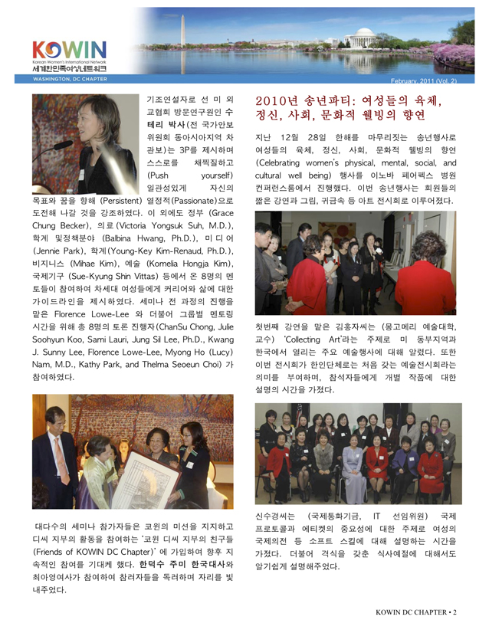

Slide 12
5th KOWIN Eastern Regional Leadership Conference
June 18, 2011: Chicago Union League Club
KOWIN DC Chapter Participants (4)
Kwang Ja Kim
Myong Ho Nam
Sue Vittas-shin
Eun Ae Lee
KOWIN DC contributed $500.00

Slide 13
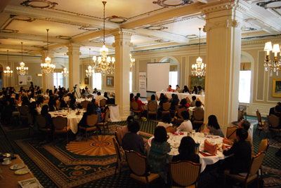
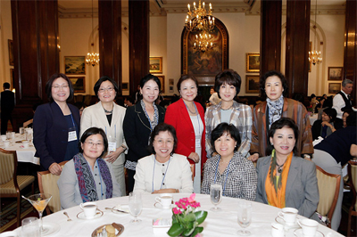

Slide 14
Dinner Reception for Minister of Gender Equality and Family by KOWIN Chicago Chapter
July 20, 2011: Glen Club, Chicago
President Myong Ho Nam attended representing DC Chapter.

Slide 15
